Slide 1

Supervisor:
Sir Muhammad Adnan
Mod Graphics
Design and Printing
Group Leader:
Ibrahim Ghaznavi
11218
Group Member:
Asif Ullah
11210
Notes:
Links:
https://unsplash.com/photos/fN603qcEA7g

Slide 2
Introduction:
It is the online application platform. In this application like cards, commercial design, brands design, and product design will be sold online and payment will be by credit card or any other payment methods.
Notes:
Links:
https://unsplash.com/photos/fN603qcEA7g

Slide 3
Tools:
Flutter
Firebase
JS
HTML
CSS
PHP

Slide 4
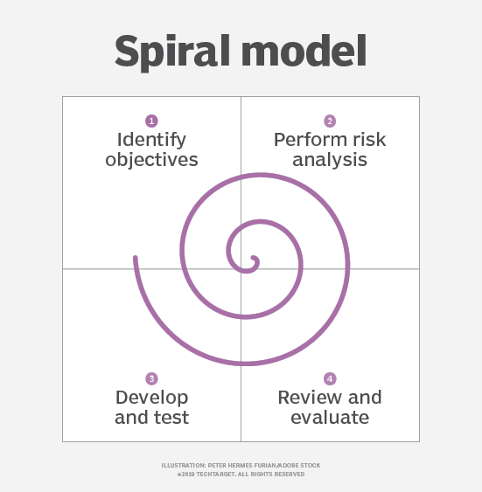
Methodology:
Spiral Model:
Requirements can be changed at any time.
Changes may be required at any time.
Identify and resolving risks.
As we know that spiral model can be used in large and complicated projects
Each phase can be end after customer satisfaction

Slide 5
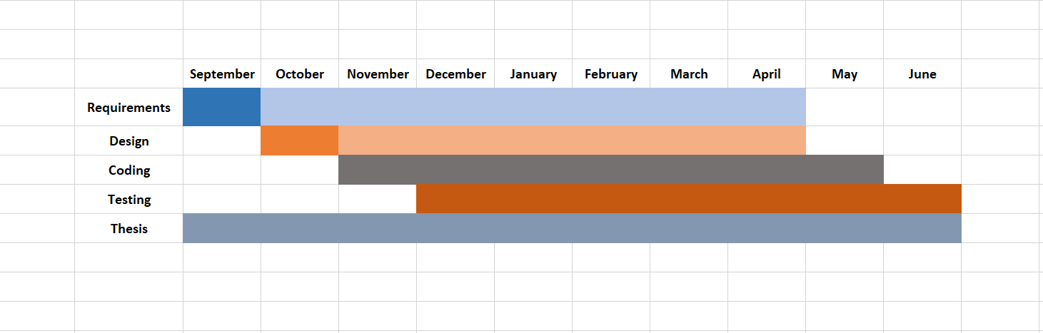
Gantt Chart:

Slide 6
Requirements:
The login page is the first page that a user opens the application which includes some functionalities:
Login:
Logo
User name (Email, Contact Number)
Password (at least 8 characters)
Create Account (Name, Email, Contact, Password, Confirm Password)
Forget Password (Email or Contact Number)
Sign up with Facebook or Gmail
Go to main page without sign in (optionally)

Slide 7
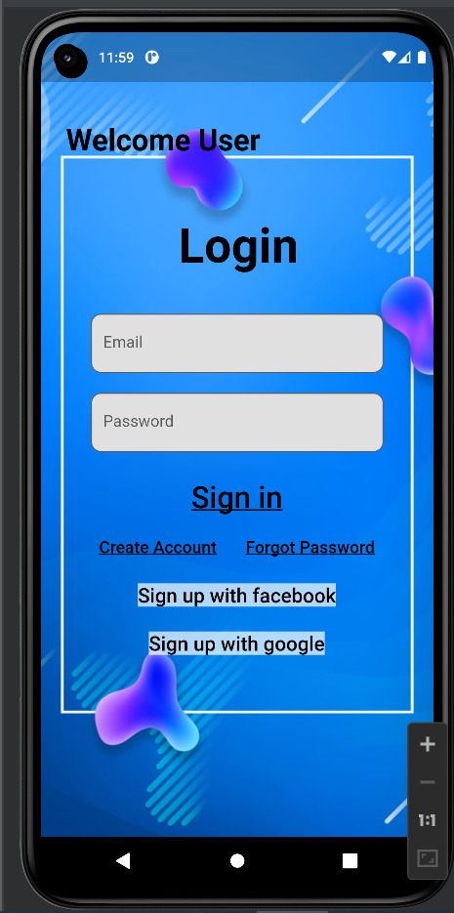
Login page

Slide 8
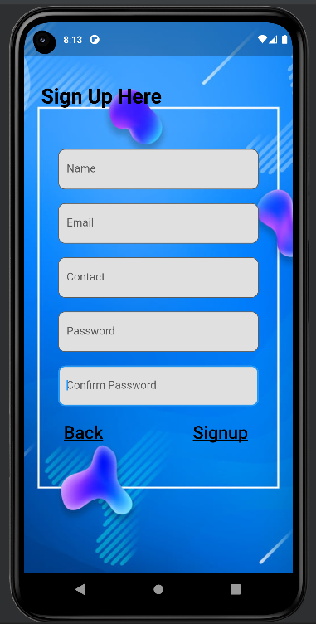
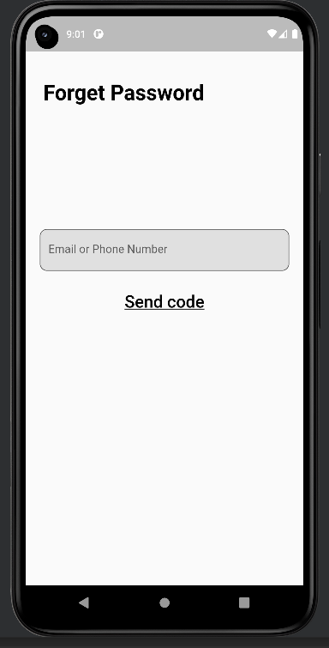
Create
Account
Forget
Password

Slide 9
Modules:
Admin
Customer
Visitor

Slide 10





Objectives:
In manual system the client and produces face a lot of problems.
Our aim is to maximize the ROI mainly profit by expanding the business and solving all the manual problems.
Title Here
Title Here
You can edit this text for your presentation
Title Here
Title Here
You can edit this text for your presentation
You can edit this text for your presentation
Notes:
Links:
https://www.pexels.com/photo/delivery-man-wearing-a-face-mask-carrying-boxes-4391478/
https://www.pexels.com/photo/delivery-man-wearing-a-face-mask-carrying-boxes-4391479/
https://www.pexels.com/photo/man-in-a-face-mask-handing-over-a-thermal-bag-to-another-man-4393668/
https://www.pexels.com/photo/man-wearing-a-face-mask-paying-for-pizza-delivery-4393444/

Slide 11

Conclusion
Easiness to people to get their work done
Maximize the profit
Easy management of the business
24/7 services available
Interactive and simple usage.
Notes:
https://www.pexels.com/photo/man-in-bubble-jacket-holding-tablet-computer-4484078/

Slide 12

Thank You!
Notes:
Links:
https://www.pexels.com/photo/black-sail-ship-on-body-of-water-906982/

